Slide 1
Athletic Trainer Pads
Team Graduate: Kate Hjorth, Adrienne Miller, Addison Azar, Mike Guyette, Caroline Cho

Slide 2
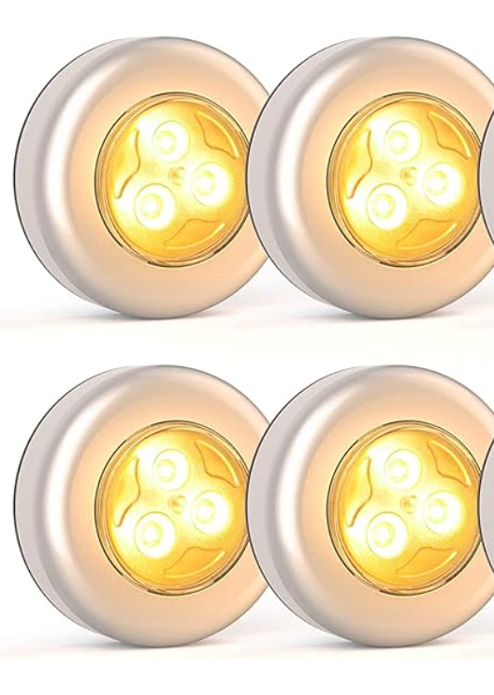
Introduction

Slide 3
Problem Description
Speed and agility drills which rely on user timing and user setup have human error
No standard for how to analyze data of reflex, accuracy, and endurance of these drills of over a period of time
Training drills are not automatically catered for the individuals without knowing strengths and weaknesses

Slide 4
Proposed Solution
Create a system that interfaces between a standardized physical activity measuring reflexes and an app that can analyze the data and grow with the user
Hardware
Four distinct circuits containing a pushbutton and LED encased in an enclosure
Pads will be structured to trigger the spring-loaded button once touched
Pads should be oriented in a square around the user, who will begin the drill in the middle
Software
Pads interface to app via ESPNow (short message protocol that works with ESP32)
User can choose how many runs to perform, the difficulty, and the type of test being run
Collect and stores the user’s data for longtime analysis
Produces user-friendly graphs to track progress over any time frame
Performs simple machine learning to update drills based off user’s unique needs

Slide 5
Demonstrated Features
4 Pads with addressable LEDs that light up
Ability of pads to detect touch
App interface that connects to pads through ESP Now
Drill options to test reflex, accuracy, endurance
Real-time data collection of time between light up and touch & accuracy of touch
Data storage of accuracy/time with analysis of trends over time
Machine learning to change drills based upon user trends

Slide 6
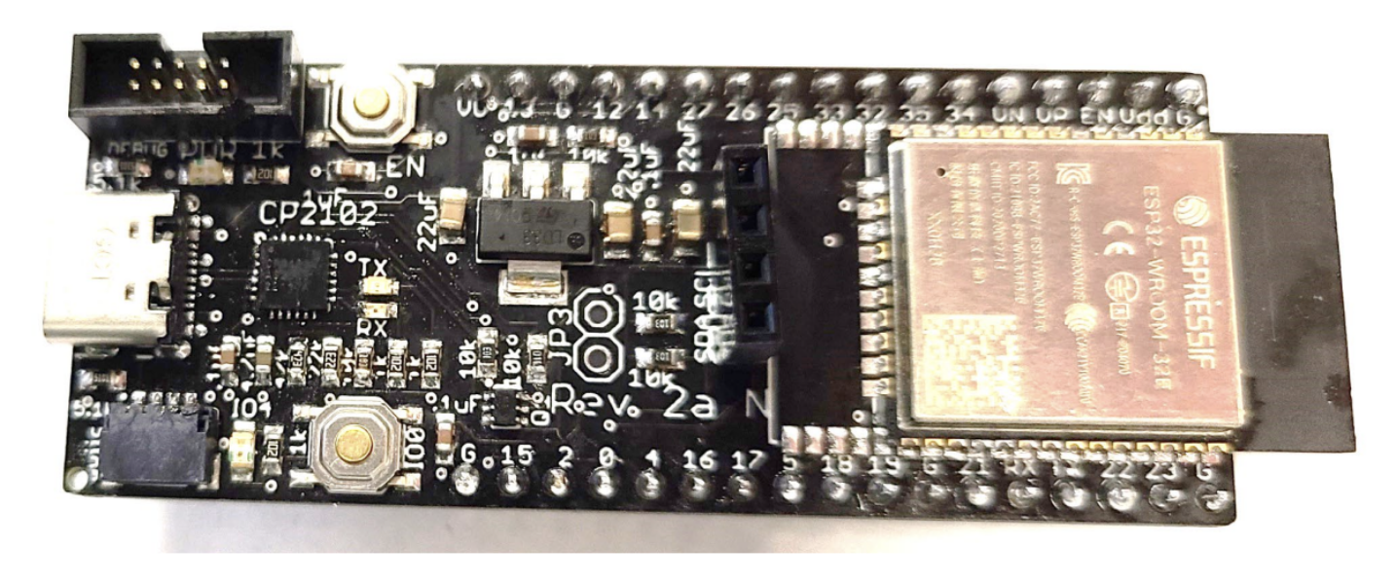
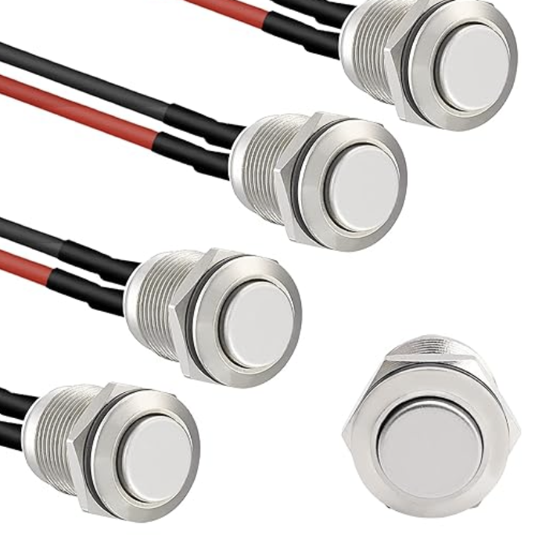
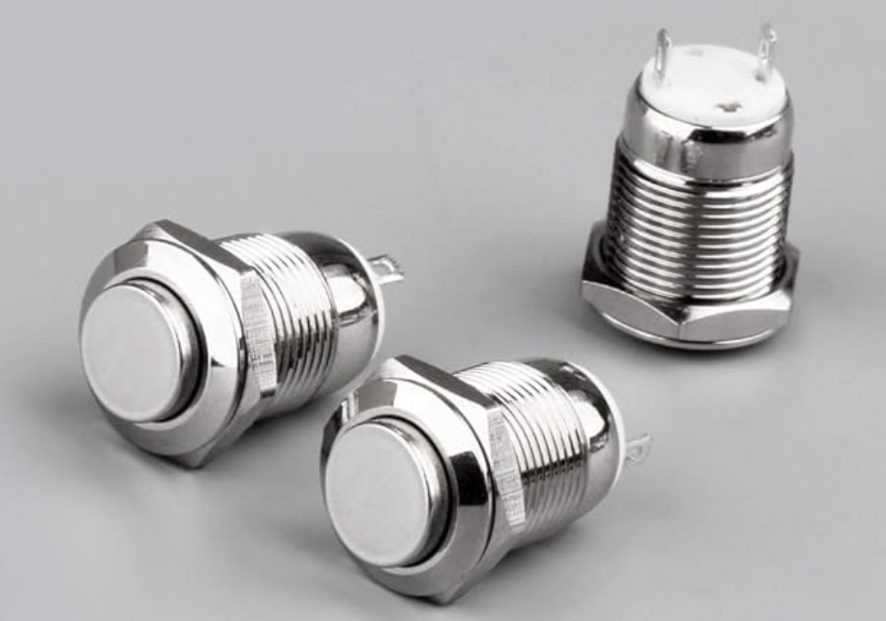
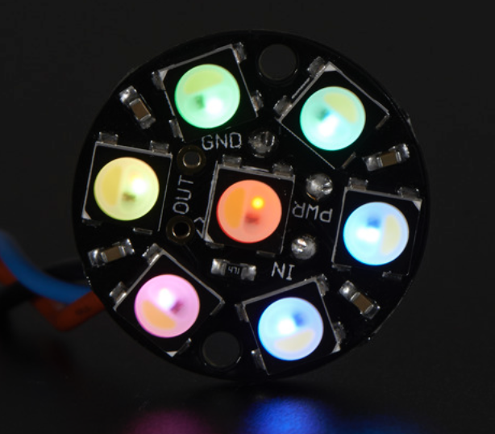
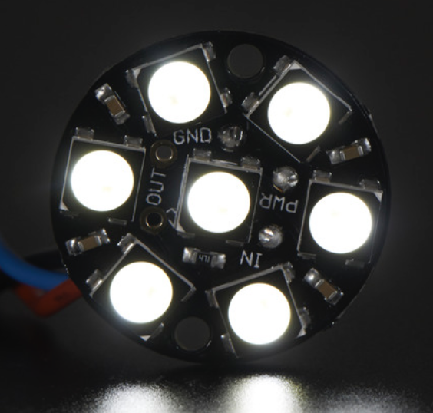
Available Technologies
ESP32-WROOM
STARELO Stainless Steel Waterproof Push Button
Gebildet Stainless Steel Waterproof Push Button
NeoPixel Jewel - 7 x 5050 RGBW LED

Slide 7
Engineering Content
4 Identical Sensor Circuits
Receive power from batteries
Cue and Feedback System
Interface with ESPNow
Physical Sensor Pad Structure
Visible addressable LEDs
Spring-loaded button
Durable and weather resistant
App Interface
Connect with ESPNow
Pre-session user inputs & transmission of parameters and LED
Receive feedback from sensors
Store and assess data according to evaluation metrics
Generate and display an evaluation report
Machine learning

Slide 8
Conclusion
What: Athletic Trainer Pads with connectivity to app interface in order to detect, store, and improve user ability in speed and reflexes
Why: Allowing users to move beyond traditional methods of measuring speed / improving agility will improve efficiency for athletic testing and physical therapy

Slide 9
Questions?

